Slide 1
Investigating Ideas
Sudin Gautam

Slide 2
A program used for a class
Some form of a calculator
A bot that makes changes to a given piece of text based on user input
A language translation bot
A bot that outputs information needed for a science method given an input (Ex. Giving inheritence percentages for different traits based allele composition)
A bot that helps plan dates for essays
A bot that simulates an investing environment

Slide 3
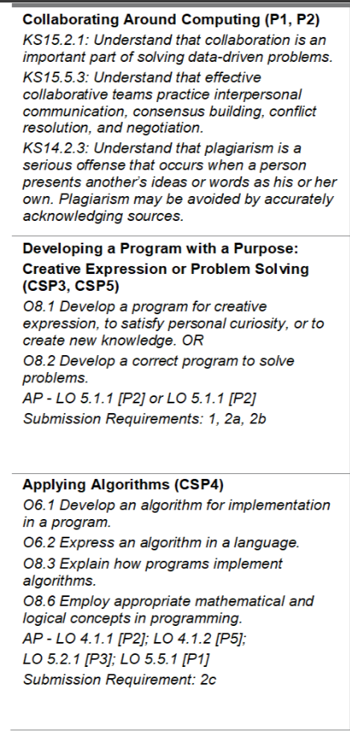
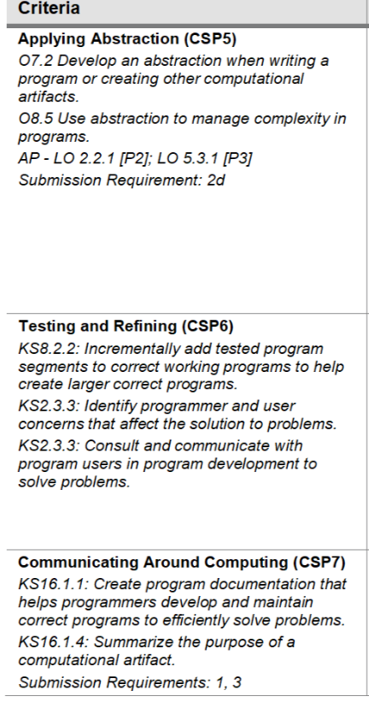
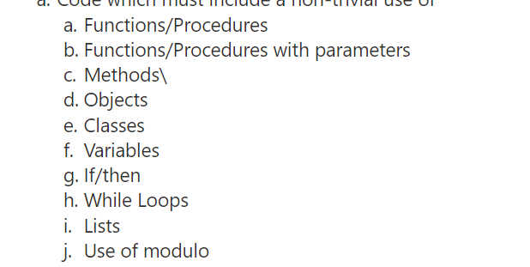
Previewing of Evaluation Criteria

Slide 4
Identifying a product that could be used by people
A calculator could be used by students in advanced math classes to speed up their calculation processes and eliminate tedious steps
A text manipulation bot could be used by students in english classes to speedily make mass changes to their text. (Ex. If a word was misspelled wrong...instead of going through every instance and changing the word, the bot would find every instance of the word and change it for them)
A bot that performs scientic processes would once again help with tedious calculations for advanced science students.
A bot that plans dates for essays could be used by english and history students alike to effectively manage writing of essays and DBQs.
A bot that replicates an investing environment could be used by students taking business classes that address that field. Furthermore, other people that want to learn how to start trading and investing using real market data would take benefit from this bot as well.

Slide 5
Top Ideas
Investing Bot
Has possibilty to reach people outside of just a school environment
Is a simulation that incorporates all aspects of the environment simulated, so is accessible to beginners and advanced users alike
Text Manipulation Bot
Provides a solution that has the most efficiency given the context of the problem
Simple to use and understand, therefore has a larger crowd of attraction

Slide 6
Final Decision
Investing bot!!!
Fun idea that encapsulates my personal interests so I am more motivated to provide quality development.
Is easily expandable and has substantially more potential for further development
Will help me personally outside of the realm of this project

